Slide 1
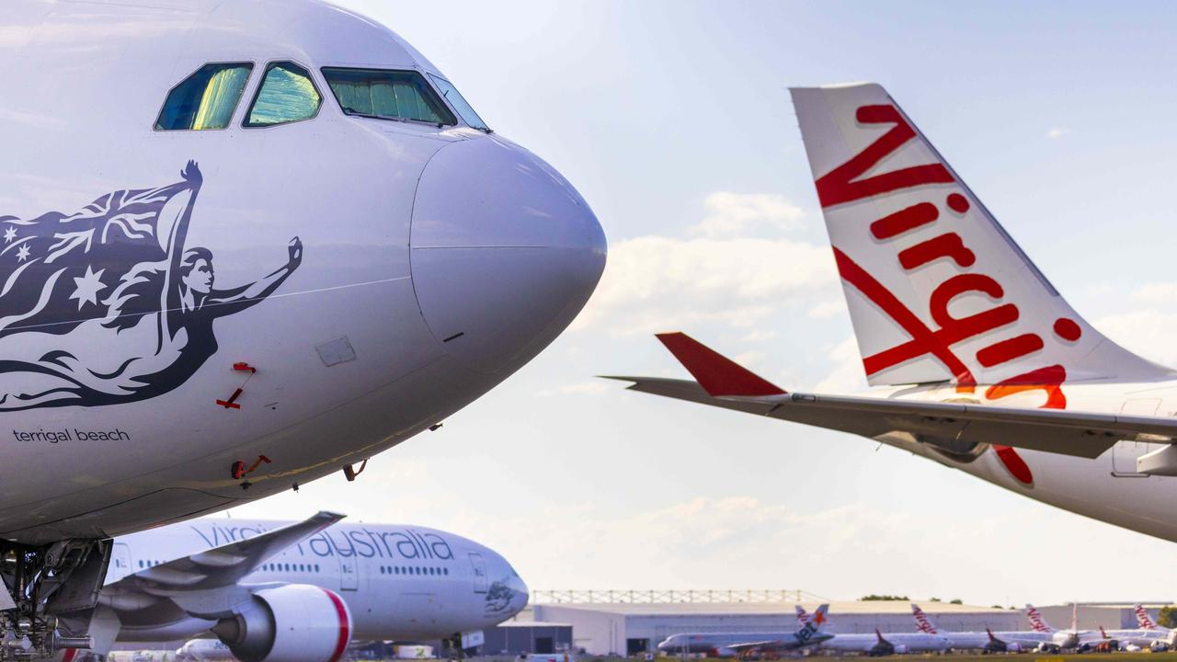
Flight Price Prediction project
Presented by
Sankalp Mahapatra
Internship 29

Slide 2
TABLE OF CONTENTS
INTRODUCTION
Business Problem Framing
Business goal
Motivation for the Problem undertaken
Exploratory Data Analysis (EDA)
Data Visualization
Model/s Development and Evaluation
Hyperparameter tuning using GridSearchCV
Conclusion

Slide 3
INTRODUCTION
Flight ticket prices can be something hard to guess, today we might see a price, check out the price of the same flight tomorrow, it will be a different story. We might have often heard travellers saying that flight ticket prices are so unpredictable.
Anyone who has booked a flight ticket knows how unexpectedly the prices vary. The cheapest available ticket on a given flight gets more and less expensive over time. This usually happens as an attempt to maximize revenue based on –
1. Time of purchase patterns (making sure last-minute purchases are expensive).
2. Keeping the flight as full as they want it (raising prices on a flight which is filling up in order to reduce sales and hold back inventory for those expensive last-minute expensive purchases).
Here we are trying to help the buyers to understand the price of the flight tickets by deploying machine learning models. These models would help the sellers/buyers to understand the flight ticket prices in market and accordingly they would be able to book their tickets.

Slide 4
Business Problem Framing
Airline industry is one of the most sophisticated in its use of dynamic pricing strategies to maximize revenue, based on proprietary algorithms and hidden variables. That is why the airline companies use complex algorithms to calculate the flight ticket prices. There are several different factors on which the price of the flight ticket depends. The seller has information about all the factors, but buyers are able to access limited information only which is not enough to predict the airfare prices. Considering the features such as departure time, arrival time and time of the day it will give the best time to buy the ticket.
Nowadays, the number of people using flights has increased significantly. It is difficult for airlines to maintain prices since prices change dynamically due to different conditions. That’s why we will try to use machine learning models to solve this problem. This can help airlines by predicting what prices they can maintain. It can also help customers to predict future flight prices and plan their journey accordingly.

Slide 5
Business goal
The main aim of this project is to predict the price of flight tickets based on various features. The purpose of the paper is to study the factors which influence the fluctuations in the airfare prices and how they are related to the change in the prices. Then using this information, build a system that can help buyers whether to buy a ticket or not. So, we will deploy an Machine Learning model for flight ticket price prediction and analysis. This model will provide the approximate selling price for the flight tickets based on different features.

Slide 6
Motivation for the Problem Undertaken
Air travel is the fastest method of transport around, and can cut hours or days off of a trip. But we know how unexpectedly the prices vary. So, I was interested in Flight Fares Prediction listings to help individuals and find the right fares based on their needs. And also, to get hands on experience and to know that how the data scientist approaches and work in an industry end to end.

Slide 7
Exploratory Data Analysis (EDA)
These are the different steps I have undertaken to perform the Exploratory Data Analysis:
Importing necessary libraries and loading collected dataset as a data frame.
Checked some statistical information like shape, number of unique values present, info, unique (), data types, value count function etc.
Checked null values and found no missing values in the dataset.
Taking care of Timestamp variables by converting data types of “Departure_time” and “Time_of_arrival” from object data type into datetime data types.
Done feature engineering on some features as they had some irrelevant values like “,”, “:” and replaced them by empty space.
The column Duration had values in terms of minutes and hours. Duration means the time taken by the plane to reach the destination and it is the difference between the arrival time and Departure time. So, I have extracted proper duration time in terms of float data type from arrival and departure time columns.

Slide 8
Extracted Departure_Hour, Deparutre_Min and Arrival_Hour, Arrival_Min columns from Departure_time and Time_of_arrival columns and dropped these columns after extraction.
The target variable "price" should be continuous numeric data but due to some string values like “,” it was showing as object data type. So, I replaced this sign by empty space and converted into float data type.
From the value count function of Meal_availability we observed "eCash 250" entry which does not belong to meals so I have replaced it as "None" and grouped same categories.
From the value count function of Number_of_stops I found categorical data so replaced them with numeric data according to stops.
Checked statistical description of the data and separated categorical and numeric features.
Performed the visualizations using count plots ,heatmaps, stripplot, boxplots and regplots. I have found out the relation between the features as well as the relation between the features and labels.
Identified outliers using box plots and found no outliers.
Encoded the columns having object data type using Label Encoder method. Used Pearson’s correlation coefficient to check the correlation between label and features. With the help of heatmap and correlation bar graph was able to understand the Feature vs Label relativity.
Separated feature and label data and feature scaling is performed using Standard Scaler method to avoid any kind of data biasness.

Slide 9
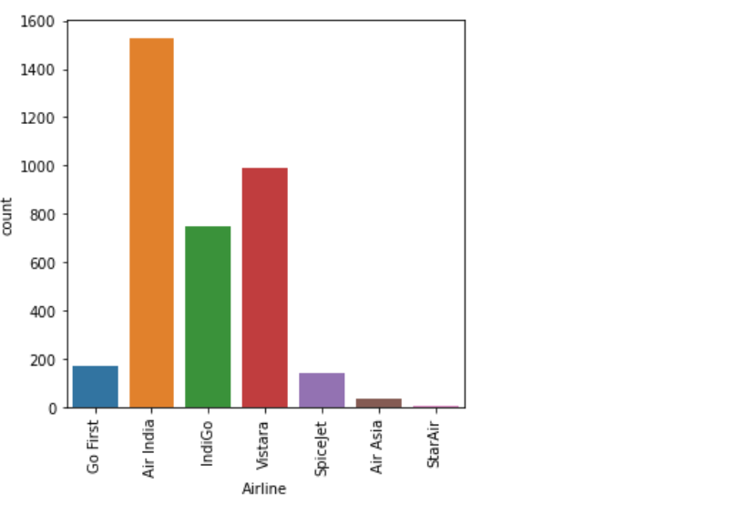
Data Visualization
I have analysed the data by plotting the relationship between the features and labels as well as the relationship among the features. I have also used box plots to find the outliers. I have count plots and distribution plot and used reg plots, scatter plots and heatmap plot. These plots have given good knowledge about the realtionships.

Slide 10
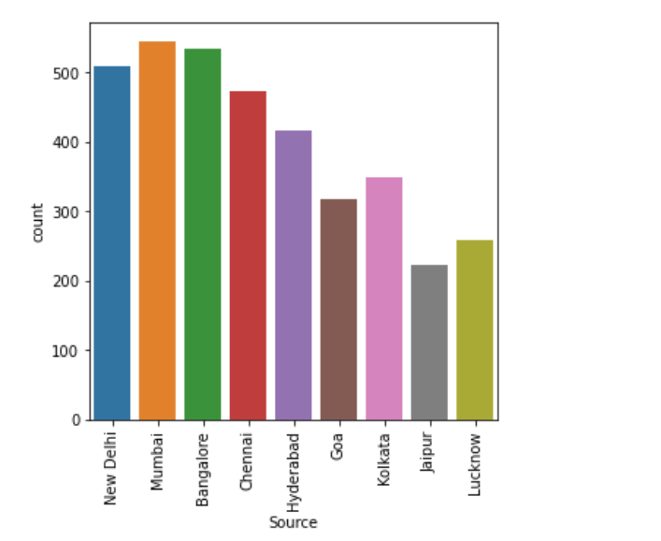
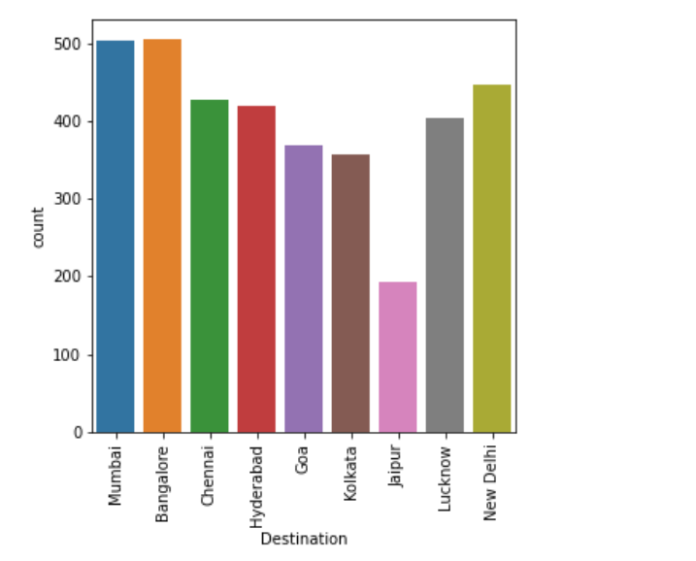

Slide 11
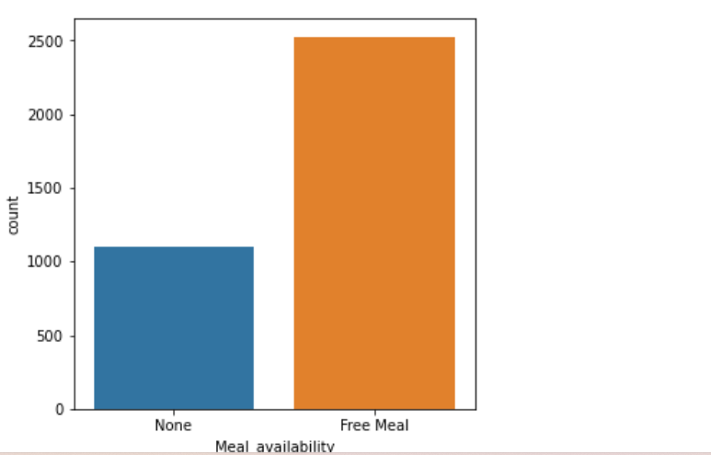

Slide 12
Observations from the count plots
Most of the flights providing free meals and only few flights are not providing any meals.
From the count plot we can observe more number of flights are from Mumbai, New Delhi, Jaipur, Kolkata and Bangalore. Only few flights are from Hyderabad.
More number of flights are heading towards Lucknow, New Delhi and Kolkata. Only few flights are travelling to Hyderabad.

Slide 13
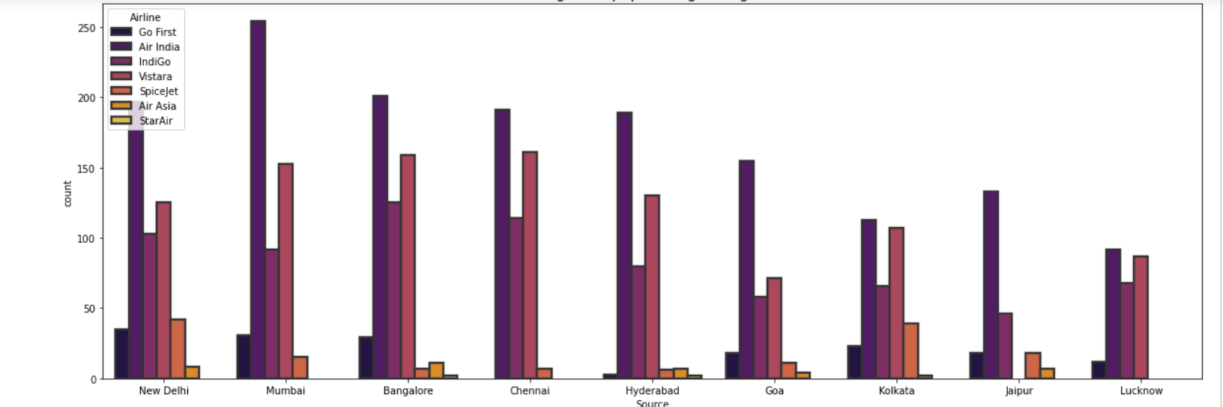
The plot shows the region wise count of airlines which tells us that Jaipur source is not having Vistara flights and it has Air India flights in higher count compared to other sources. Other sources have Air India, Vistara and Indigo flights with higher count.

Slide 14
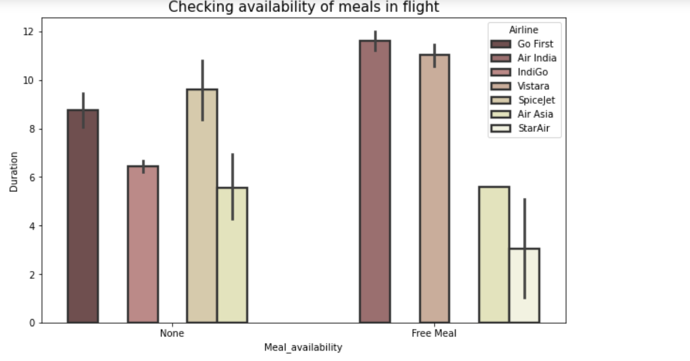
All the airlines provides free meals during the journey having the duration below 11 hours.
now the data looks good and there is no missing values and Object values so we can start visualizing the type of distribution for each feature.

Slide 15
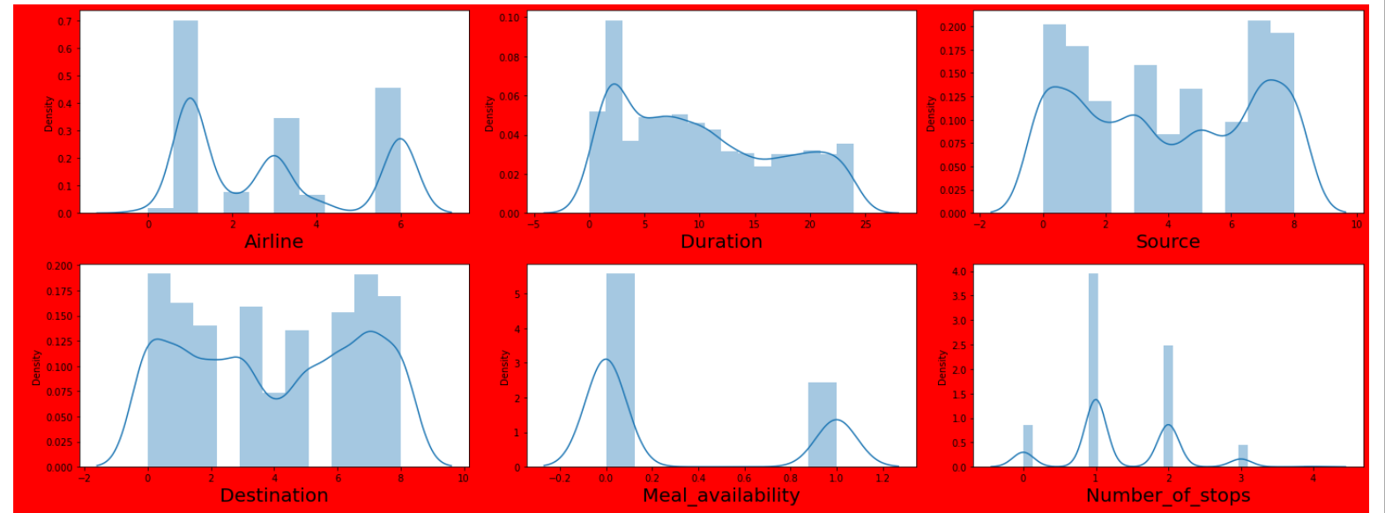
Plotting distplots to find out about the distribution of the data

Slide 16
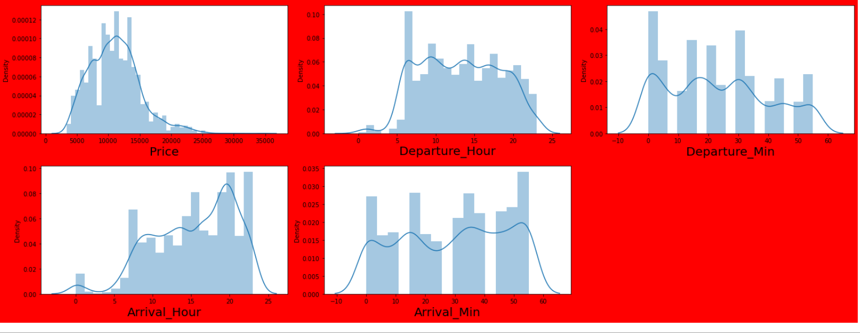

Slide 17
Observations from the distplots
From the distribution plot we can observe the columns are somewhat distributed normally as they have no proper bell shape curve.
The columns like "Duration", "Number_of_stops" and "Price" are skewed to right as the mean value in these columns are much greater than the median(50%).
Also the data in the column Arrival_Hour skewed to left since the mean values is less than the median.
Since there is presence of skewness in the data, we need to remove skewness in the numerical columns to overcome with any kind of data biasness.

Slide 18
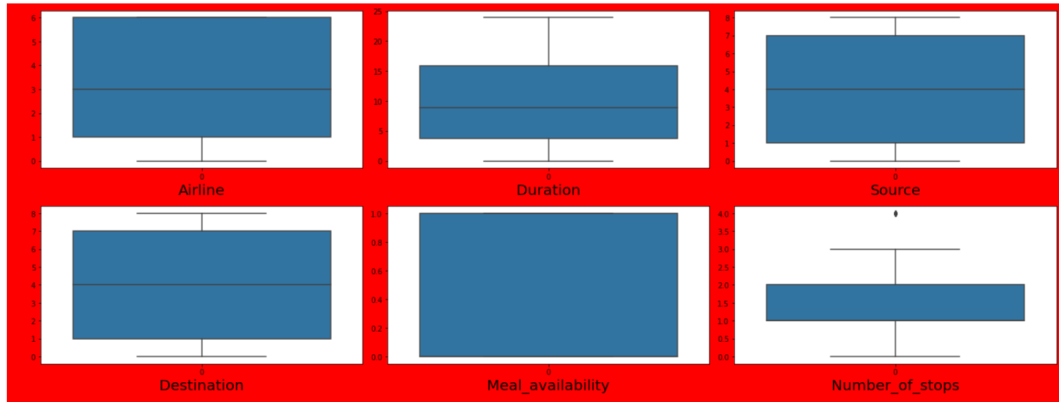
Plotting box plots to find out Outliers

Slide 19
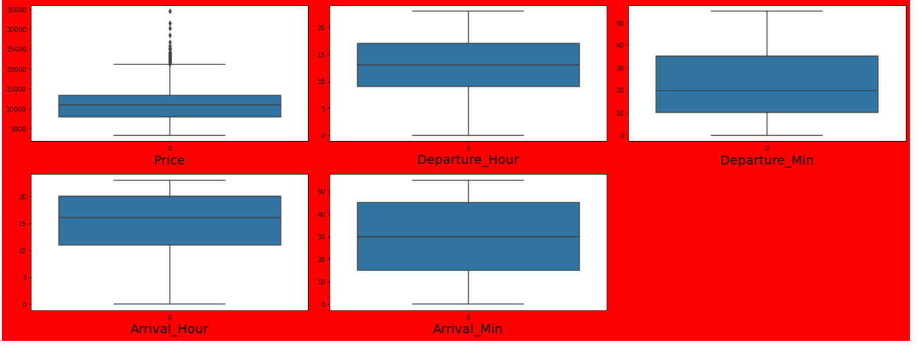

Slide 20
Observations from the box plots
The outliers present in Number_of_stops and "Price" columns.
Since Price is our target column and Number_of_stops is our categorical variable so no need to remove outliers in this columns. Finally there is no need to remove outliers in the dataset.

Slide 21
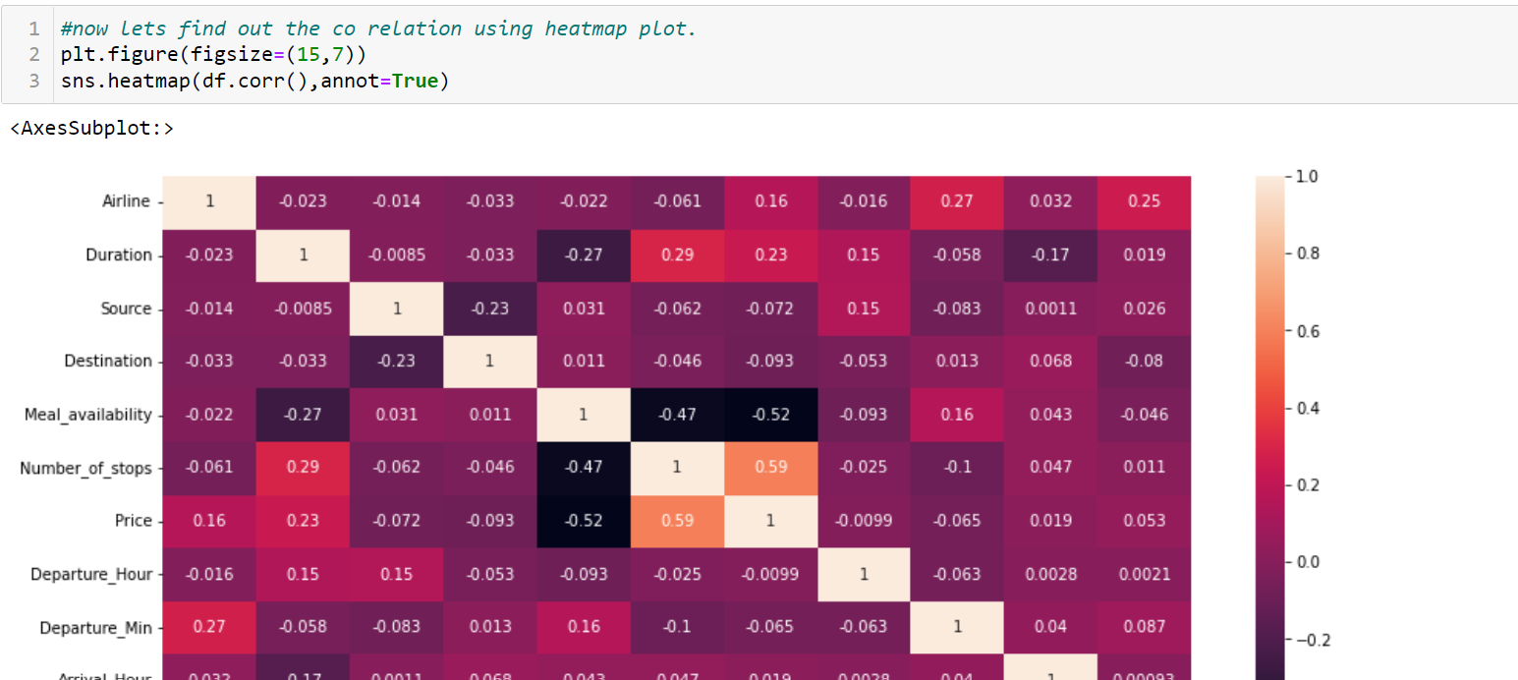
Plotting heatmap to find out the multicolinearity.

Slide 22
Observation from the heatmap
This heat map contains both positive and negative correlation.
The features Number_of_stops, Duration Arrival_Hour and Airline are highly positively correlated with the target column compared to other features.
The other features have very less correlation with the target column.
From the map we can also observe there is no multicollinearity issue exists.

Slide 23
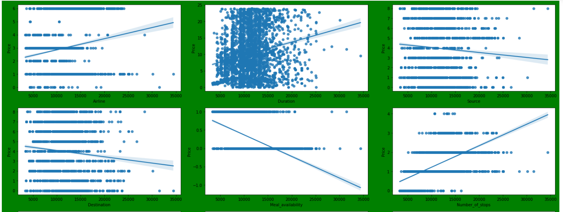
Plotting Regplots to find out the relationship between the features and labels.

Slide 24
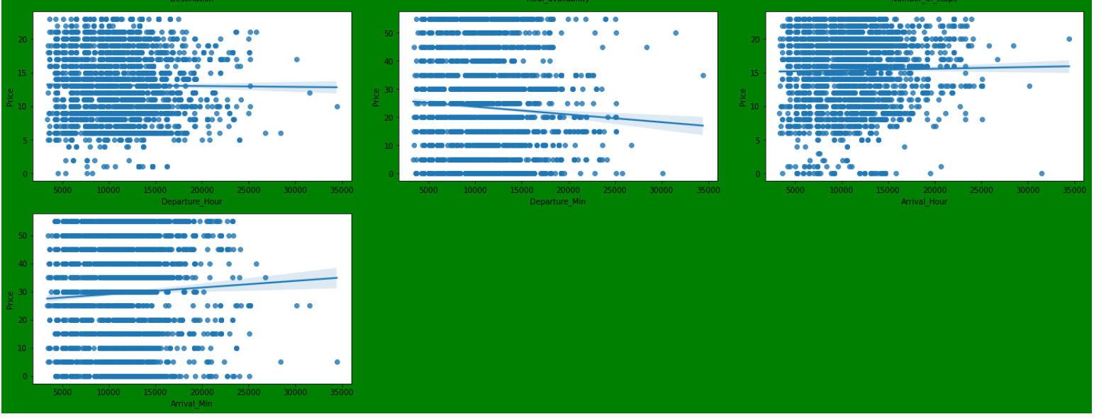

Slide 25
Observations from the regplot
airlines have positive relation with ticket prices.
we can say as the stops shows anegative relationship with ticket price decreases.
Flight source has positive relationship with the price.
flights having Free meal facility have high ticket prices.
there is no significant difference between price and departure min.
we can conlude arival hour has some positive correlation with price.
We can say flight ticket prices are not much dependent on the Arrival_min.
we can observe some positive linear relation between Duration and Price.

Slide 26
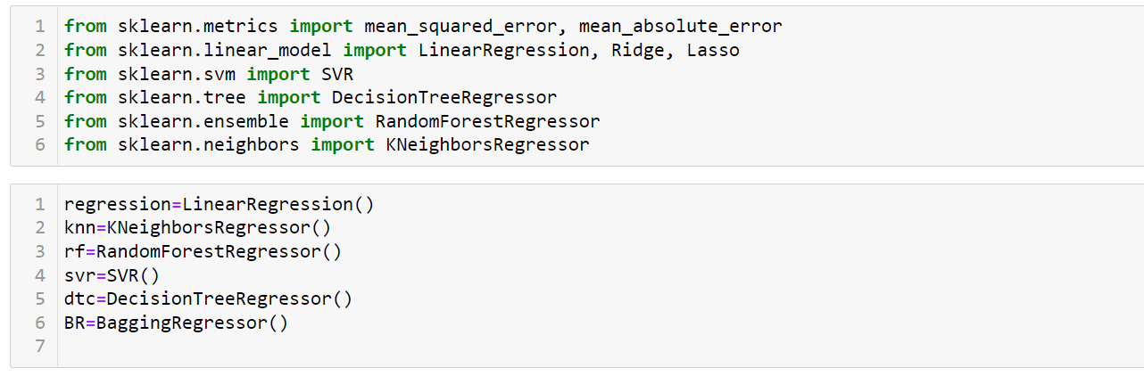
Model Development and Evaluation
Importing the required libraries and declaring the models.

Slide 27
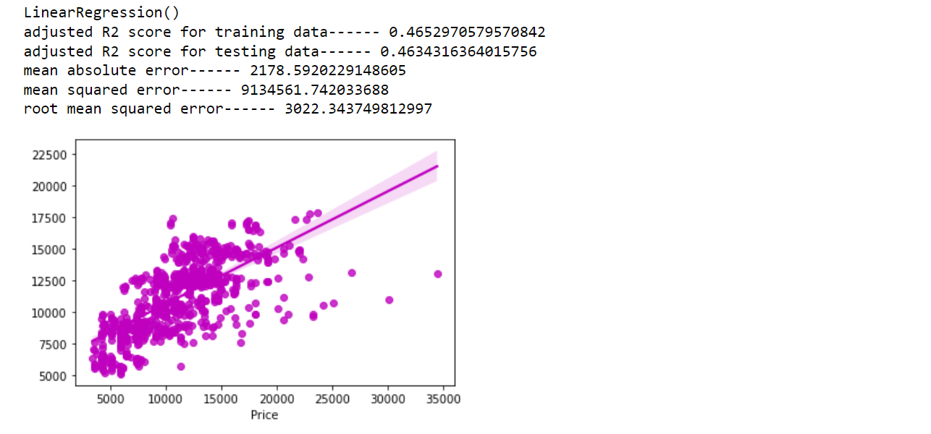
Linear Regression Model

Slide 28
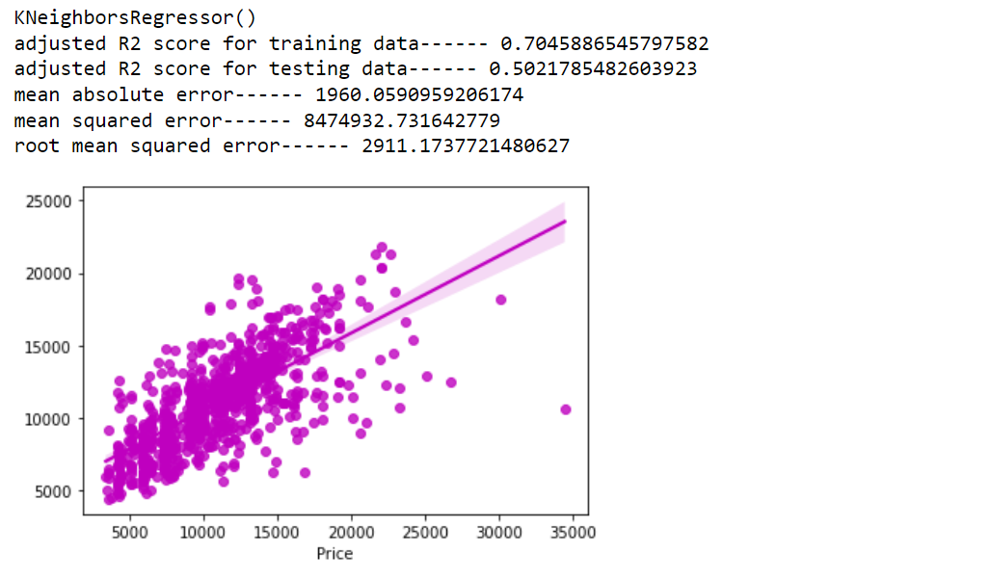
KNearestNeighbour Regressor Model

Slide 29
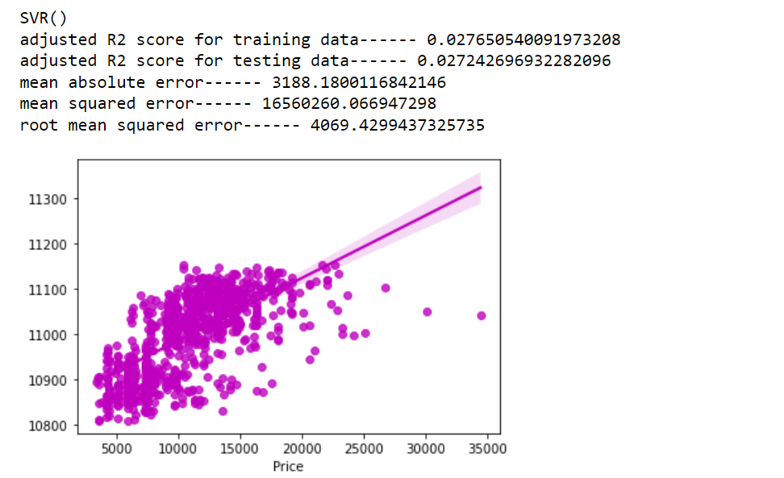
SVR Model

Slide 30
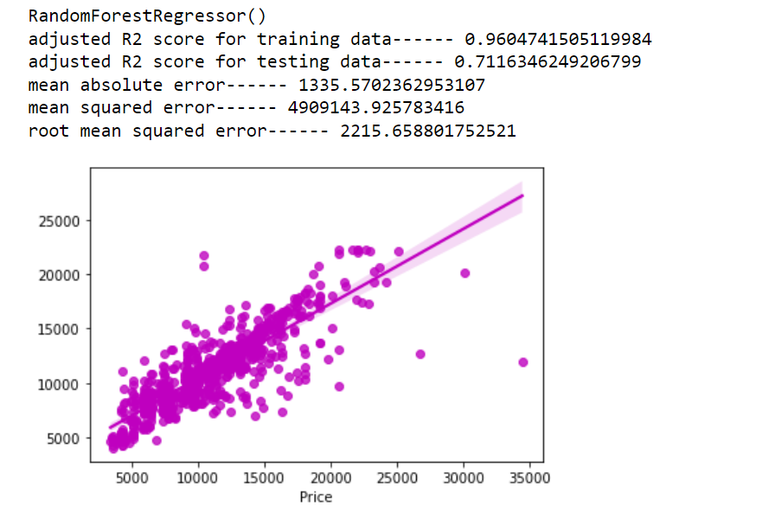
RandomForest Regressor Model

Slide 31
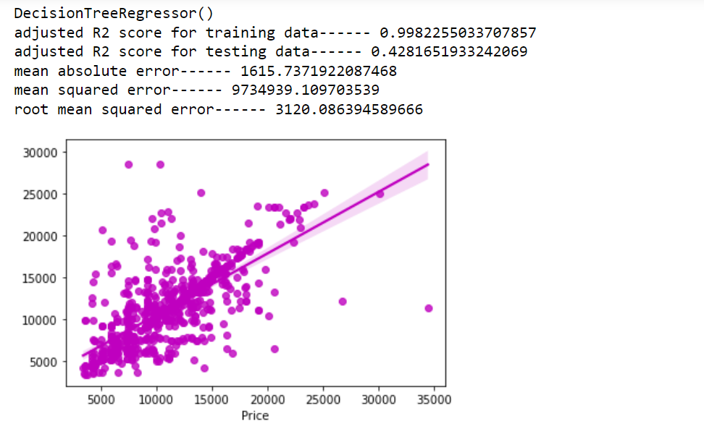
Decision Tree Regressor

Slide 32
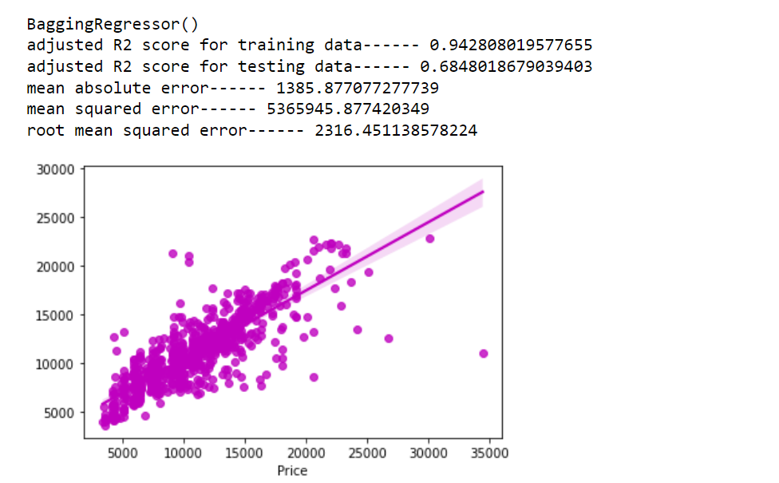
Bagging Regressor

Slide 33
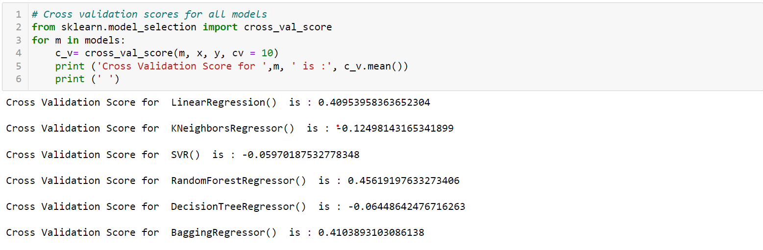
Cross-Validation Scores for all the Models

Slide 34
Choosing the best Model(Model Selection)
After analysing all the models we have concluded that RandomForestRegressor() model gives the best R2 score and cross validation score. And based on the R2 score we have chosen RandomForestRegressor() as the best model. We will use RandomForestRegressor() model for further analysis.

Slide 35
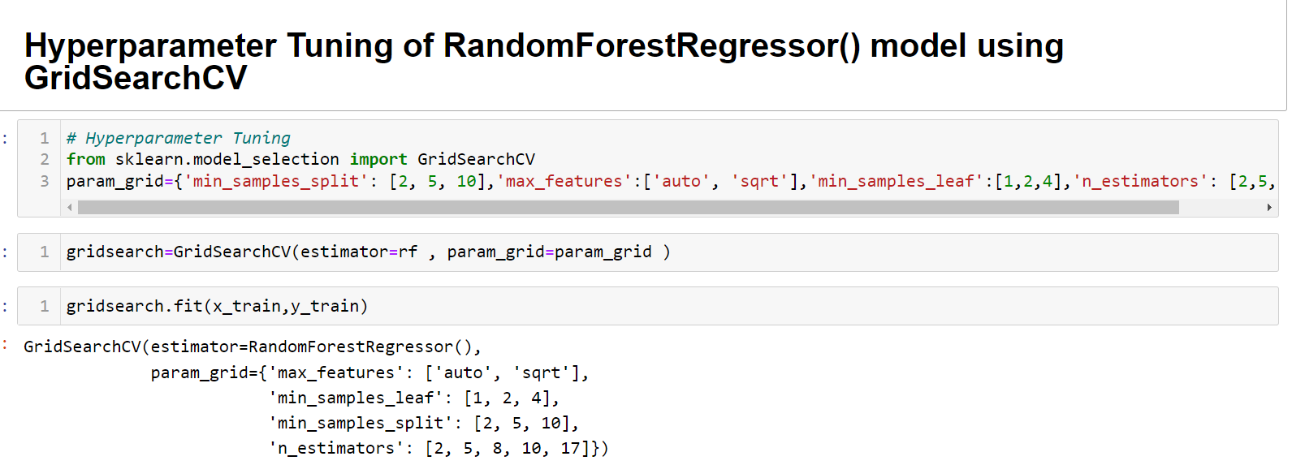
Hyperparameter Tuning of RandomForestRegressor() model using GridSearchCV

Slide 36
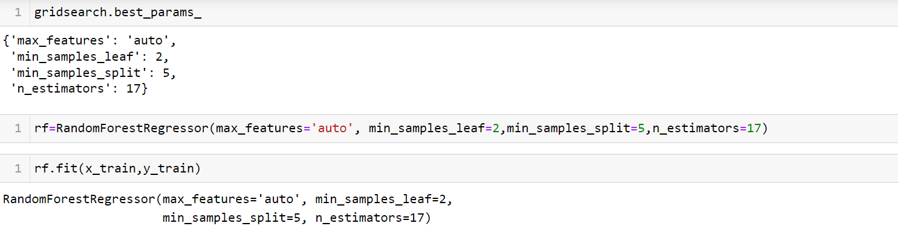
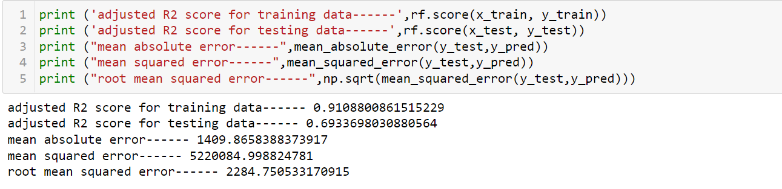

Slide 37
Conclusions
The case study aims to give an idea of applying Machine Learning algorithms to predict the price of the flight tickets. After the completion of this project, we got an insight of how to collect data, pre-processing the data, analyse the data, cleaning the data and building a model.
In this study, we have used multiple machine learning models to predict the flight ticket price. We have gone through the data analysis by performing feature engineering, finding the relation between features and label through visualizations. And got the important feature and we used these features to predict the car price by building ML models. Performed hyper parameter tuning on the best model and the best model’s R2 score has not increased from 71%. We have also got good prediction results of ticket price.

Slide 38
Limitations of this work and scope for future work
Limitations: The main limitation of this study is the low number of records that have been used. In the dataset our data is not properly distributed in some of the columns many of the values in the columns are having string values which I had taken care. Due to some reasons our models may not make the right patterns and the performance of the model also reduces. So that issues need to be taken care.
Future work: The greatest shortcoming of this work is the shortage of data. Anyone wishing to expand upon it should seek alternative sources of historical data manually over a period of time. Additionally, a more varied set of flights should be explored, since it is entirely plausible that airlines vary their pricing strategy according to the characteristics of the flight (for example, fares for regional flights out of small airports may behave differently than the major, well flown routes we considered here). Finally, it would be interesting to compare our system's accuracy against that of the commercial systems available today (preferably over a period of time).

